Slide 1
Category review: Chips
February2024
Retail Analytics
Brand note: If client logo is not required, use alternate title page layout right click slide thumbnail > Layout > Title

Slide 2
Notes:
To view Privacy video explaining how important data privacy is to Quantium, please click here: https://www.youtube.com/watch?v=Zq1QDAkoRzU
or here Q:\Company Reference\Brand & Design\Brand videos\Q Privacy.mp4
At Quantium, we believe that data is the behavioural footprint of humanity and that it has to be treated with the utmost care and responsibility.
Histories, attitudes, indeed lives are stored within it in ways that aren’t always apparent – and that’s what makes its potential so powerful.
To work with it responsibly, sensitively, we set ourselves the highest data privacy protection and governance standards.
We have spent 17 years perfecting privacy-by-design and secure-by-design principles. Central to this is not holding any personally identifiable information about people –
we neither receive it, and put the necessary protections in place to be unable to decipher it.
Every aspect of handling data is safeguarded: from its de-identification, to its encryption – data security is paramount and of the highest grade.
We pride ourselves on gaining the trust of iconic organisations around the world through years of securely working with their data,
and in turn the trust that builds with their stakeholders.

Slide 3
Executive summary
01
Task 1: Overview of chips sales and getting key information.
Comparing chips sales overtime from 2018 to 1019.​
Impact of customer's influence and spending habits.​
Customer's life stage and influence impact on spending habits.
02
Task 2: Trial store performance.
Overall the trial stores outperformed the control stores in every category during this period.​
The trial stores do show a leveling out performance in the third month.​
Two out of three stores are showing higher levels in every category compared to the control stores at the end.

Slide 4
01
Overview of Chips Sales and key information:

Slide 5
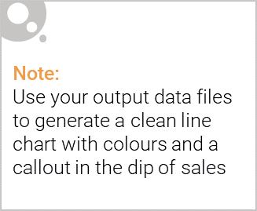
Total sales trend for past year​
Sales totals for the year 2019 has decreased from 2018. Showing slight improvement in month June.​

Slide 6
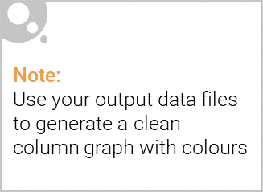
Customer affluence and it’s effect on customer buying
As we can see on the graph below mainstream customer made the made the most chips purchases with budget customers in second. It does not seem affluence has a large impact on chips sales as one would expect.

Slide 7
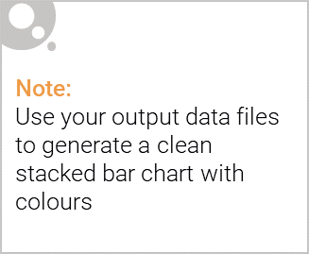
Editable (delete this)
Life stage with proportion of premium customer
The data shows that older people tend to purchase more chips across all life stage demographics and affluence. With new families being the lowest.

Slide 8
02
Trial store performance

Slide 9
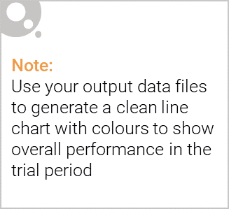
Trial stores v/s Control stores
The data shows that the trial stores have increased sales from February and ends with a slight decline in April.
The control stores declined from February and since levelled out March into April.
Total Sales during trial

Slide 10
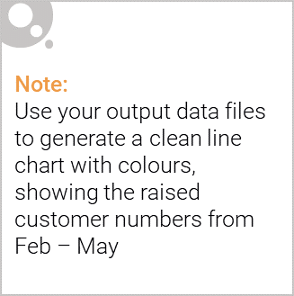
Trial stores v/s Control stores: Transactions
The data shows that the trial stores have increased sales transactions from February and ends with a slight decline April.
Control stores declined from February, since levelled out March into April. While control store 233 continued a decline.
Trail store 77 v/s Control store 233
Trail store 86 v/s Control store 155
Trial store 88 v/s Control store 237

Slide 11
Recommendations:
Total customer chips transactions
Two of the three stores are outperforming their control stores.
One store continued to increase after the trial period.
Showing a possible change in customer purchase behaviour in store 77.
The other two trial stores 86 and 88 declined in sales back to it’s original sales output.
The data is showing some decrease in performance in the third month for the stores. A levelling out in sales is expected.
My recommendation would be to convert the stores into the new layout. After six months I would consider another study to see the impact the new layout has had across a larger sample of stores and how the sales volume is trending overtime.

